Slide 1
Managing Daily Process Excellence
Gemba Leadership Tools for a Lean Organization

Slide 2

Other Modules In This Series:
5S
Standard Work
Total Productive Maintenance (TPM)
Administrative Lean
Cell Design/ Production Preparation Process (3P)
Kaizen
Kanban
Problem Solving
Poka Yoke Quality Systems
Transaction Process Improvement (TPI)
Cause & Effect Diagram with the Additions of Cards (CEDAC)
Single Minute Exchange of Dies (SMED)
Value Stream Mapping (VSMi®)
Visual Management
Managing Daily Process Excellence
For More Information Please Contact:
Mark DeLuzio, President and CEO
+1.860.234.0915
mark.deluzio@leanhorizons.com
Strategically Creating Value Through the Elimination of Waste

Slide 3
This document contains confidential
and proprietary information owned
by Lean Horizons Consulting, LLC.
Any disclosure, use, copying or
distribution of this information without the express written consent of Lean Horizons Consulting is strictly prohibited.

Slide 4
Managing for Daily Process Excellence
Goal of MDPE Module
To define the MDPE process and to how use it to drive daily business performance and sustainable results at Gemba.
Commitment to Transformation
(Lean Basics)
Develop and Implement KPIs at Gemba
Continuous Improvement in Gemba
Notes:
DO: Introduce the notion of MDPE and the goal of this event.
At this time it is appropriate for the Process Owner or the Kaizen Team Leader to review the charter and objectives of the event.

Slide 5
Managing for Daily Process Excellence Agenda
    Managing Daily Process Excellence (MDPE) Overview
Gemba Exercise
Lean Basics Assessment and KPI Development
Installing MDPE: Manage the MDPE Levers at Gemba
Sample Templates and Best Practices

Slide 6
Managing for Daily Process Excellence Agenda
    Managing Daily Process Excellence (MDPE) Overview
Gemba Exercise
Lean Basics Assessment and KPI Development
Installing MDPE: Manage the MDPE Levers at Gemba
Sample Templates and Best Practices

Slide 7
Managing Daily Process Excellence (MDPE) Overview
MDPE is the process an organization uses to manage at the Gemba
Key Steps Description
1
KPI Metrics at Gemba
Define the measures of success as measured by both the Organization and the Customer. They should be easy to understand and to measure
2
Visual Management at Gemba
Visual Management boards at each cell of work cluster. Key Performance Indicators posted on board, measured and reviewed at least daily, Must contain Root Cause and Countermeasure (RCCM)
3
Root Cause
And
Countermeasure at Gemba
RCCM present in each work area, with focus on rapid improvement and longer term fixes to systemic problems. Gemba employees drive to RCCM, not just leadership
4
Daily Leadership
At
Gemba
Management leads a daily review of performance. Same time every day, same agenda. Each MDPE meeting should be rolled up to an organization wide performance board daily. Allows transparency to total daily performance
5S, SW / Standard Process are the minimum tools required to support MDPE

Slide 8
What are the core elements of MDPE?
Four Core Elements of Managing Daily Process Excellence (MDPE) at Gemba
Gemba Leadership
Of MDPE
Visual Management in place
KPI’s Established
Lean Basics: 5S, Standard Work / Standard Process

Slide 9
What are the expected benefits of MDPE?
1
Improvement in value stream performance
Creates focus on the items that provide the most impact to the business…VA (value add) and reduces the NVA (non value add) activities
2
Drives Linkage
Supports alignment with meeting and exceeding KPI and Annual Improvement Priorities
3
Solve problems at the source
Drives resolution of a problem’s root cause rather than temporary fixes to meet short term goals
4
Sustainability
Creates an environment where changes/ improvements to processes are sustained!!
5
Knowledge Transfer
Creates a standard process for continuous learning and exchanging best practices

Slide 10
What are the Core Leadership Concepts of MDPE?
Set People Up To Win
“Lean Basics”
Define What Winning Is
Uphold The Parameters
Of Winning
Workforce trained in
Lean Basics
5S all areas
Standard Work in place
Materials at the point
of use
Establish Key Performance Indicators (KPI’s)
Visual Management in place
Establish ownership for process and results
Root cause and countermeasures expected
Remove non-value add activity through spot kaizen of formal kaizen
Daily review of KPI’s at Gemba
Daily Gemba walk to observe Standard Work
Request and implement employee improvement suggestions
Reward individuals and teams who deliver KPI results using standard process
Inspect what you expect…recognize sustained improvement

Slide 11
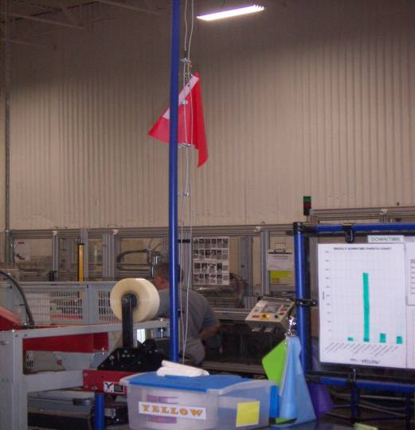
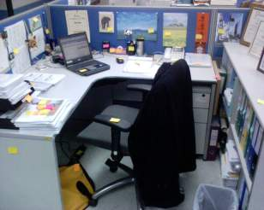
What is…and Where is Gemba?
A Japanese word meaning “real place”
Today, adapted to mean “workplace”
In a lean organization, Gemba refers to the place where the employees “add value” to the product or service
Gemba is any place in the organization where value is added
Notes:
SAY: “Where value is added could be in a place other than manufacturing.”
FOR REFERENCE: Gemba: the real place (‘gen’: ‘real’; ‘ba’, from ‘bamen’: ‘place’, ‘scene’, ‘situation’; i.e. ‘the actual spot’; ‘the precise location’). In a manufacturing company, ‘the place where the value is added’. Certain grammatical rules dictate that this may sometimes be translated alternatively as ‘gemba’.

Slide 12

Where will MDPE have the greatest impact?
Top Mgt
Strategy Deployment
Middle
Mgt
Kaizen
Supervisor
Managing Daily
Process Excellence Focus
Front Line
Associate
0%
50%
100%
Time

Slide 13
Managing Daily Process Excellence Relationship to Strategic Deployment
MDPE Delivers Data to the Strategic Deployment Process
KPI’s will support or refute progress in your Annual Improvement Priority efforts
Root cause at Gemba provides data for root cause at Strategic Deployment level
Strategic Deployment discipline requires that there is MDPE discipline
at Gemba
AIP 1
AIP 2
AIP 3
MDPE
And
KPI’s
MDPE
And
KPI’s
KPI performance helps us understand what system improvement needs to be breakthrough

Slide 14
Managing for Daily Process Excellence Agenda
    Managing Daily Process Excellence (MDPE) Overview
Gemba Exercise
Lean Basics Assessment and KPI Development
Installing MDPE: Manage the MDPE Levers at Gemba
Sample Templates and Best Practices

Slide 15
Exercise: Gemba Walk
Objective
Understand the effort needed to see value being added at Gemba
Instructions
Time to Complete
In either pairs or foursomes go to Gemba and spend 15 minutes observing a person or team of people performing their job.
Write your observations down. Focus on nature of the work, standardization, and coordination.
Return to the classroom and discuss your observations.
60 minutes
Deliverable
Be prepared to share with the larger group.

Slide 16
Managing for Daily Process Excellence Agenda
    Managing Daily Process Excellence (MDPE) Overview
Gemba Exercise
Lean Basics Assessment and KPI Development
Installing MDPE: Manage the MDPE Levers at Gemba
Sample Templates and Best Practices

Slide 17
Installing Managing Daily Process Excellence
Critical Concepts to understand:
Leadership (Executive and Gemba Level) Commitment to “Lean Basics” and MDPE are a critical first step to driving results at Gemba
Each organization is at a different point in the “Lean Journey ” and therefore will require different levels of MDPE intervention
“Lean Basics” of 5S and Standard Work / Standard process are the foundation of MDPE, they must be in place!
Commitment to Transformation
(Lean Basics)
Develop and Implement KPIs at Gemba
Continuous Improvement in Gemba

Slide 18
Where are you with your deployment of Lean Basics in Operations?
Is a cellular arrangement with material moving
counter-clockwise or work flow present?
Is standard work or standard process established,
and managed through a playbook?
Is there visibility to inventory and is it moved to
point-of-use?
Is there an inventory replenishment system
(kanban) in place?
Scorecard at end cell / work area indicating
how we are doing vs plan?
Implementing the Lean Basics and MDPE in parallel yields the best results
Notes:
SAY: “When you start and you get your cells going in the Lean Transformation Process – here are the 5 things you want to have in place.”
ASK: “When these are in place – how are you going to run them? How are you going to manage this plant once the cells are in place?” (answer: MDPE)

Slide 19
Where are you with your deployment of Lean Basics in the Back Office?
Is there a visible work flow present?
Is a standard process established,
with clear work instructions?
Is there visibility to demand, inventory and
materials needed?
Are there visible cues for “ready to hand off” or
completed work?
Is a Scorecard visible in work area indicating
how we are doing vs plan?
Implementing the Lean Basics and MDPE in parallel yields the best results
Notes:
SAY: “When you start and you get your cells going in the Lean Transformation Process – here are the 5 things you want to have in place.”
ASK: “When these are in place – how are you going to run them? How are you going to manage this plant once the cells are in place?” (answer: MDPE)

Slide 20
Exercise: Breakout Session, Lean Basics Audit
Objective
Complete a Lean Basics audit.
Instructions
Time to Complete
As a team, complete the Lean Basics audit for your business. Go to Gemba!
Tools to use:
File: Lean Basics Audit Form
15 minutes
Deliverable
Presentation of completed audit.
Notes:
NOTE: With completed matrix, instruct class on how this information would be transferred to a Bowling Chart, and how the information would be reviewed monthly – if off plan, discuss the use of countermeasures to get back on track.

Slide 21
What are the “Right KPI’s”?
SAFETY
QUALITY
DELIVERY
PRODUCTIVITY or COST
Gemba KPI’s should define winning with the Customer and the Organization
Keep them simple
Understand the levers of change
Understand how one KPI is linked to another
KPI Basics:

Slide 22
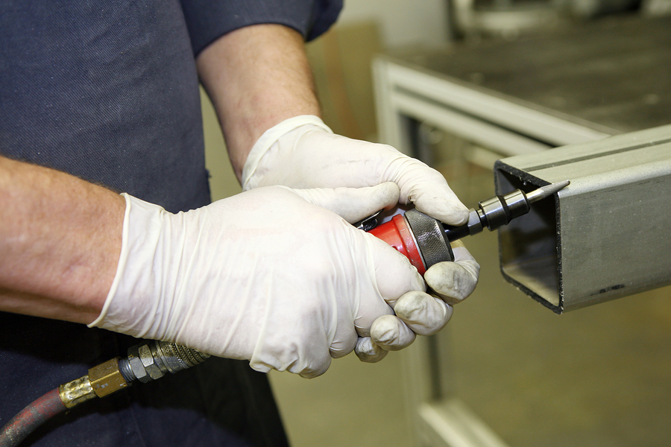
What are the “Right KPI’s”?
Safety
Work at Gemba should always be done in a safe and environmentally healthy manner
Sample metrics include:
  OSHA recordable rate
  Safety incidents per employee hour worked

Slide 23

What are the “Right KPI’s”?
Quality
Quality should be built into every step of the process
Sample metrics include:
  PPM
  Defects per hour
  Call abandon rate
  Missed shipments per hour
  Out of box failures

Slide 24
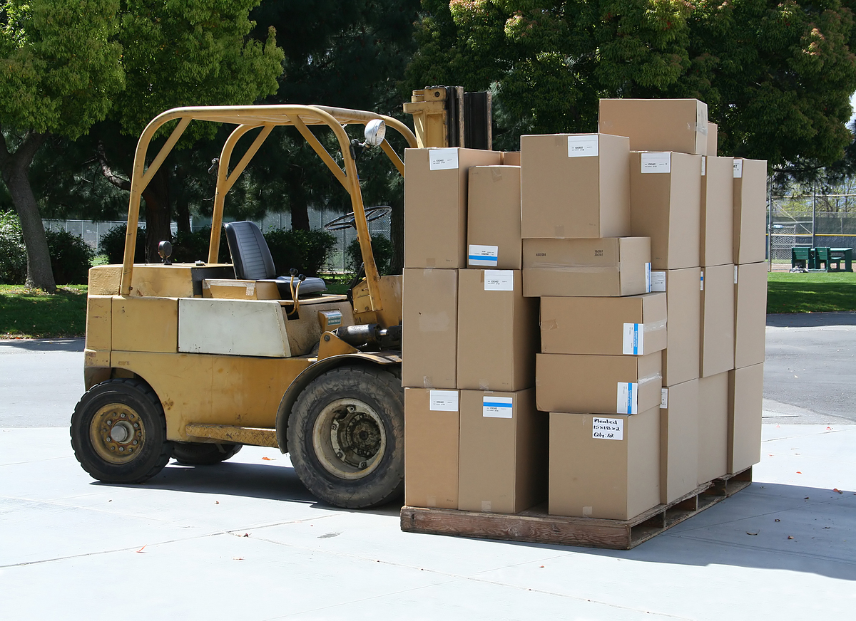
What are the “Right KPI’s”?
Delivery
Delivery to the customer when the customer wants it
Sample metrics include:
  On-time delivery to customer
  On-time delivery to warehouse
  On-time arrival of service technician
  Time to fill professional positions

Slide 25
What are the “Right KPI’s”?
Productivity or Cost
Cost focuses on organization cost to produce/provide product or service
Sample metrics include:
  Kits per hour
  Orders entered per hour
  Sales per employee

Slide 26
Exercise: KPI Development
Objective
Identify the KPI’s needed in your area.
Instructions
Time to Complete
In work terms, discuss and develop your KPI’s
Provide:
What are the KPI’s
How will they be measured
What is the goal of target
2 Key Levers that can influence the KPI
60 minutes
Deliverable
Be prepared to share with the larger group.

Slide 27
Managing for Daily Process Excellence Agenda
    Managing Daily Process Excellence (MDPE) Overview
Gemba Exercise
Lean Basics Assessment and KPI Development
Installing MDPE: Manage the MDPE Levers at Gemba
Sample Templates and Best Practices

Slide 28
The Four Levers of MDPE Management
All 4 Levers are necessary to drive MDPE into an Organization
Manage KPI’s at Gemba
Visual Management at Gemba
Employees understand KPI’s
Employees calculate KPI’s
Employees review KPI’s
Visual Board at Gemba
Performance to Daily Plan
Standard format throughout
Gemba RCCM
Gemba Level Leadership
Employees trained in Problem Solving
Both Root Cause and Countermeasure are tracked
Leaders are present at Gemba daily for reviews
Leaders teach at Daily Review
Ownership of the process at both the Employee and the Leader levels
ensures sustainability

Slide 29
The Four Levers of MDPE Management
All 4 Levers are necessary to drive MDPE into an Organization
Manage KPI’s at Gemba
Visual Management at Gemba
Employees understand KPI’s
Employees calculate KPI’s
Employees review KPI’s
Visual Board at Gemba
Performance to Daily Plan
Standard format throughout
Gemba RCCM
Gemba Level Leadership
Employees trained in Problem Solving
Both Root Cause and Countermeasure are tracked
Leaders are present at Gemba daily for reviews
Leaders teach at Daily Review
Ownership of the process at both the Employee and the Leader levels
ensures sustainability

Slide 30
MDPE for Safety
Safety Audits
Implementation Best Practices
Set Safety Improvement Targets
Safety Committee
Safety Suggestions System
Employee led audits
Safety Improvement Reward System
Cross Training
Incident Investigation Training
Safety Promotions with Training
Install 5S Discipline to maintain, TPM to improve
Implement Safety reviews after all Kaizens
Leadership Gemba Level Review

Slide 31
MDPE for Quality
Change for Quality Audit of Product to Process
Implementation Best Practices
Build Quality Checks and Poke Yoke into the Process
Teach employees about Process and Systems
Poke Yoke where you can
Involve Design Teams
Involve Customers
Involve Suppliers
Get good at Root Cause identification
Measure Daily
Drive to Root Cause
Involve Employees in Countermeasures

Slide 32
MDPE for Delivery
Implement Flow
Implementation Best Practices
Measure to Customer Request Date
Flow, and or Cells
Establish Standard Measure with Customer
Establish standard work / standard process through out the supply chain
Cross Training (Multi-skilled is more valuable than specialist)
Employees own the metric hourly / daily
Use quick hit kaizen or event based kaizen to drive continuous improvement customer focused culture
Measure Hourly / Daily
Drive STD WK or STD Process
Improve Process to reduce lead time

Slide 33
MDPE for Productivity / Cost
Define the Measure
Implementation Best Practices
Measure at the Work Group or Cell Level
Metric must be easy to calculate and easy to understand across the organization
Drive down to the cell or work group level to provide employee understanding of performance
Leaders must observe all element of the process at Gemba
Employees own the metric hourly / daily
Use quick hit kaizen or event based kaizen to drive continuous improvement customer focused culture
Set stretch goals in order to drive continued process improvement
Leaders spend time at Gemba to observe and diagnose issues
Use Kaizen to improve
Regularly set new goals

Slide 34
The Four Levers of MDPE Management
All 4 Levers are necessary to drive MDPE into an Organization
Manage KPI’s at Gemba
Visual Management at Gemba
Employees understand KPI’s
Employees calculate KPI’s
Employees review KPI’s
Visual Board at Gemba
Performance to Daily Plan
Standard format throughout
Gemba RCCM
Gemba Level Leadership
Employees trained in Problem Solving
Both Root Cause and Countermeasure are tracked
Leaders are present at Gemba daily for reviews
Leaders teach at Daily Review
Ownership of the process at both the Employee and the Leader levels
ensures sustainability

Slide 35
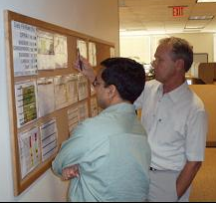
Gemba Level Visual Management
Moves from having only "specialists" understand to an environment where everyone understands
Allows for easy identification of problems
Facilitates the prioritization of where to allocate resources to solve problems
Mandates “walk around” management at the Gemba (NO OPTION!)
Tells you if you are making progress
Requires taking ownership over
the program
Visual Management makes the MDPE Process more effective

Slide 36
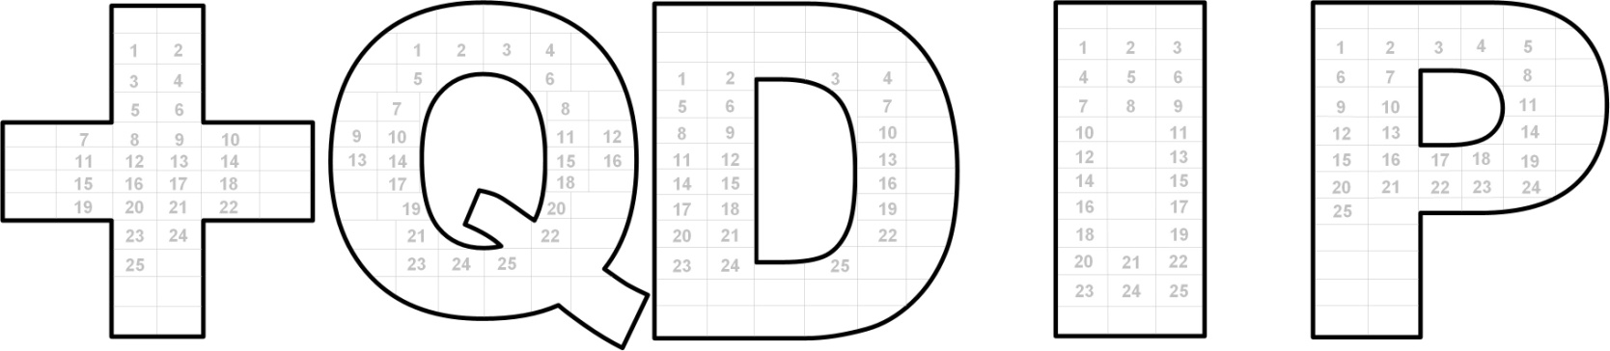
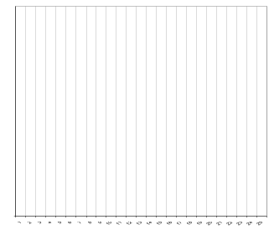
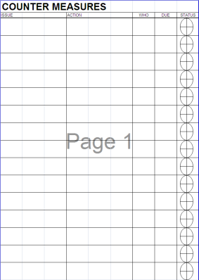
Example of a Visual Management Board Standard
Are We Green, or Red
What is our Historical Data
Are our CM’s working?

Slide 37
Exercise: To Gemba or not to Gemba, that is the question!
Objective
Discuss the importance of MDPE at Gemba
Instructions
Time to Complete
Break into 2 teams.
Team 1 will review performance data that will been provided.
Team 2 will go to Gemba and review the data that will be provided.
Both teams will report out on their conclusion as to what the performance issues are and root cause.
45 minutes
Deliverable
Report out on problems identified and root cause

Slide 38
The Four Levers of MDPE Management
All 4 Levers are necessary to drive MDPE into an Organization
Manage KPI’s at Gemba
Visual Management at Gemba
Employees understand KPI’s
Employees calculate KPI’s
Employees review KPI’s
Visual Board at Gemba
Performance to Daily Plan
Standard format throughout
Gemba RCCM
Gemba Level Leadership
Employees trained in Problem Solving
Both Root Cause and Countermeasure are tracked
Leaders are present at Gemba daily for reviews
Leaders teach at Daily Review
Ownership of the process at both the Employee and the Leader levels
ensures sustainability

Slide 39
RCCM Process at Gemba
Standard Process
When a problem arises...go to
Gemba first
Go to Gemba and see how the problem is occurring…listen to employees at Gemba
Fully understand the impact down the value stream or process
Establish short-term CM’s with ownership of understanding the effectiveness
Use a team effort to define Root Cause and establish Countermeasures
Deploy CM’s and measure intensely in the shot-term
Verify the problem and impact
Put Short-term
Countermeasures in place
Find Root Cause
Develop and Deploy CM…
Standardize to Sustain
Planned Culture Change Can Accelerate Business Performance

Slide 40
The Four Levers of MDPE Management
All 4 Levers are necessary to drive MDPE into an Organization
Manage KPI’s at Gemba
Visual Management at Gemba
Employees understand KPI’s
Employees calculate KPI’s
Employees review KPI’s
Visual Board at Gemba
Performance to Daily Plan
Standard format throughout
Gemba RCCM
Gemba Level Leadership
Employees trained in Problem Solving
Both Root Cause and Countermeasure are tracked
Leaders are present at Gemba daily for reviews
Leaders teach at Daily Review
Ownership of the process at both the Employee and the Leader levels
ensures sustainability

Slide 41
Core MDPE Leadership Process
How to drive performance using MDPE
Define Winning
Set People Up to Win
Uphold the Parameters
Lean is the only option
Set expectations
Make it clear what Winning looks like
Make it clear what Losing looks like
Only define expectations that you are serious about
Uses 5 Whys
Is Data Driven
Expects stretch results
Teaches Lean Tools
MDPE Leadership Style

Slide 42
Core MDPE Leadership Process
How to drive performance using MDPE
Define Winning
Set People Up to Win
Uphold the Parameters
Lean is the only option
Are they set up with the right resources, people, time, dollars, capital?
Do people know what you think of their work?
How do you communicate to them?
How do you manage with positive expectancy?
Uses 5 Whys
Is Data Driven
Expects stretch results
Teaches Lean Tools
MDPE Leadership Style

Slide 43
Core MDPE Leadership Process
How to drive performance using MDPE
Define Winning
Set People Up to Win
Uphold the Parameters
Lean is the only option
Inspect what you expect
React to what you find
Consistency is critical across the factory
Apply feedback that is: Immediate and Specific
Coach to Win
The “Gemba Walk” process upholds parameters
Uses 5 Whys
Is Data Driven
Expects stretch results
Teaches Lean Tools
MDPE Leadership Style

Slide 44
Core MDPE Leadership Process
How to drive performance using MDPE
Define Winning
Set People Up to Win
Uphold the Parameters
Lean is the only option
There is no choice but to run organization with Lean principles…
No excuses...
Start with Lean Basics
Do MDPE with your team—drive kaizen as needed
Drive change using Lean tools and data
Uses 5 Whys
Is Data Driven
Expects stretch results
Teaches Lean Tools
MDPE Leadership Style

Slide 45
Exercise: Leadership Development
Objective
Identify four Leadership Elements and which one you need to improve
Instructions
Time to Complete
In each team/cell, identify an issue in the cell that the Four Leadership Elements could be applied to (e.g., repetitive part shortage, etc.). In your team, discuss how you could:
Define the Parameters
Set Up People to Win
Uphold the Parameters
Drive Lean Principles
15 minutes
Deliverable
Each team must report out answers to the group. Report out should include action items that can be implemented this week, included in daily work going forward, or in Managing Daily Process Excellence Action Plan.

Slide 46
Managing for Daily Process Excellence Agenda
    Managing Daily Process Excellence (MDPE) Overview
Gemba Exercise
Lean Basics Assessment and KPI Development
Installing MDPE: Manage the MDPE Levers at Gemba
Sample Templates and Best Practices

Slide 47
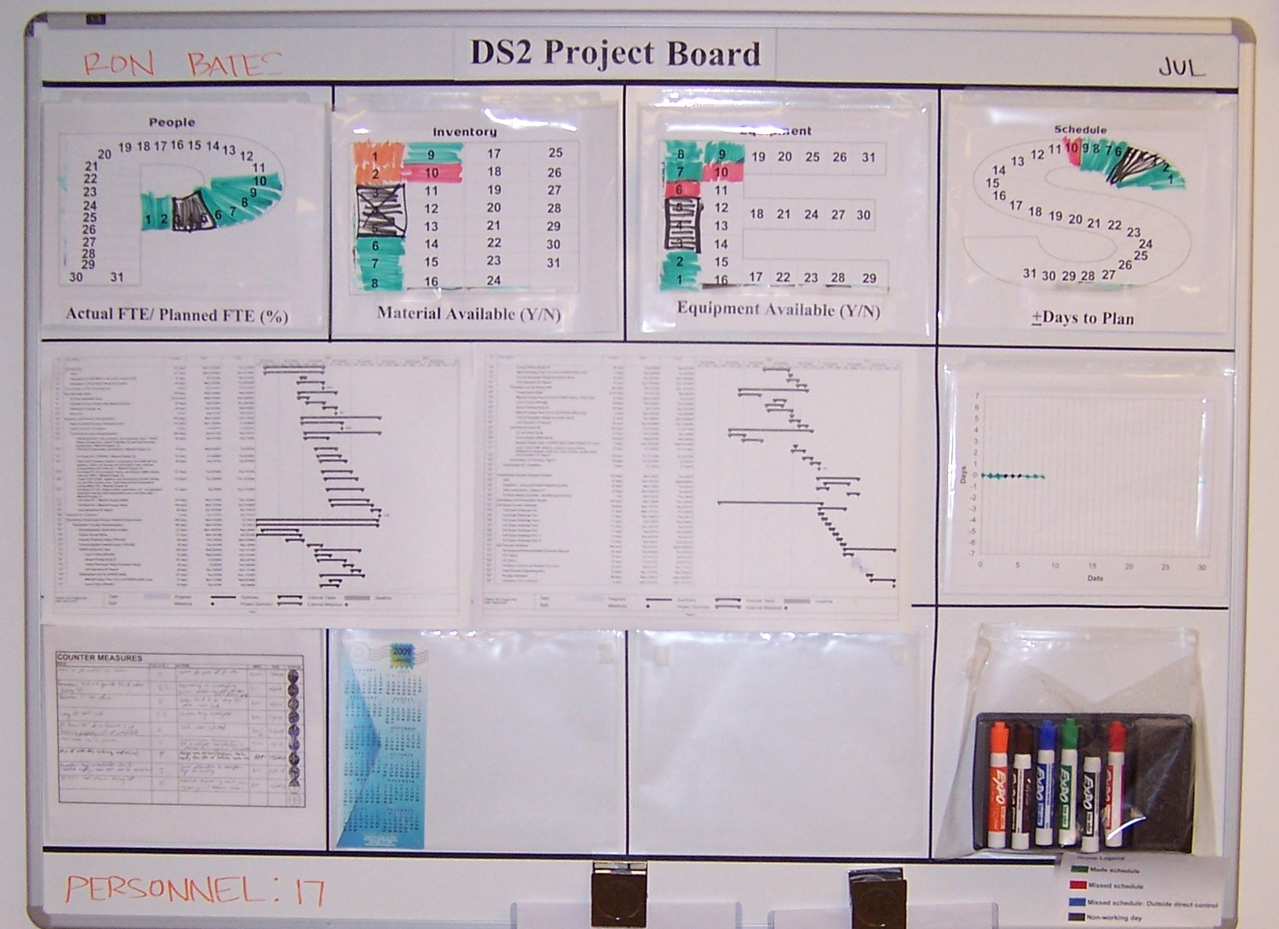
Daily Management Lab Examples
Project 3 Board

Slide 48
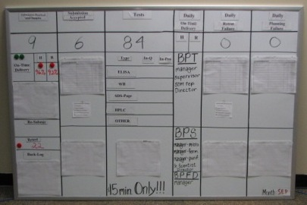
Daily Management Cross Department Example

Slide 49
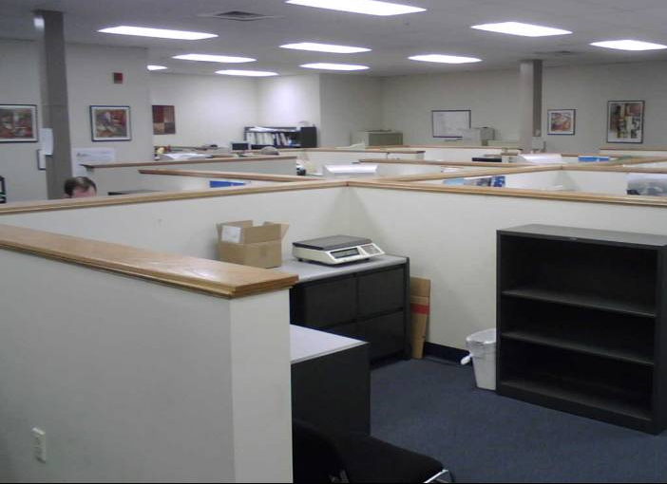
Non-Operations Example of an Open Office Environment
Notes:
SAY: “This layout is conducive to open communication and real time problem solving.”

Slide 50
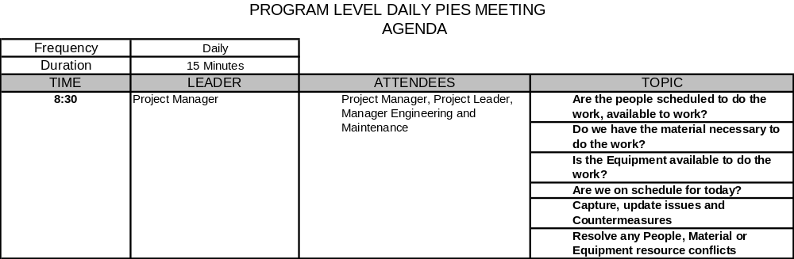
Sample MDPE Agenda

Slide 51
Other Modules In This Series:
5S
Standard Work
Total Productive Maintenance (TPM)
Administrative Lean
Cell Design/ Production Preparation Process (3P)
Kaizen
Kanban
Problem Solving
Poka Yoke Quality Systems
Transaction Process Improvement (TPI)
Cause & Effect Diagram with the Additions of Cards (CEDAC)
Single Minute Exchange of Dies (SMED)
Value Stream Mapping (VSMi®)
Visual Management
Managing Daily Process Excellence
For More Information Please Contact:
Mark DeLuzio, President and CEO
+1.860.234.0915
mark.deluzio@leanhorizons.com
Strategically Creating Value Through the Elimination of Waste

